Slide 1




Hack4Dev
CubeSat Challenge
Team 3
Gabriel Christino
Marcela Gouvêa
Matheus Poltronieri

Slide 2
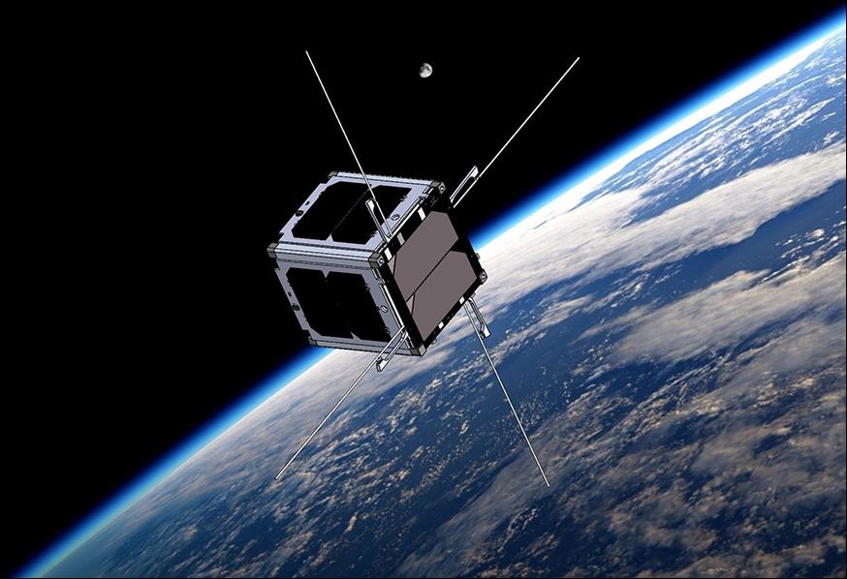
Introduction : CubeSat Challenge
01
VERTECS
The VERTECS satellite aims to study star formation history by observing extragalactic background light in the optical range. It uses a small telescope and precise attitude control to gather data.
02
Problem
Due to its small size, the VERTECS nanosatellite has limited computing power, storage, and communication capacity. This results in slower data transmission, making it difficult to send large amounts of data quickly and affecting mission efficiency.
03
Challenge
Improve the efficiency and accuracy of a machine learning model that classifies data captured by CubeSats in order to prioritize images that are most valuable for transmission back to Earth, given the limited onboard resources and slow data downlink speeds.

Slide 3
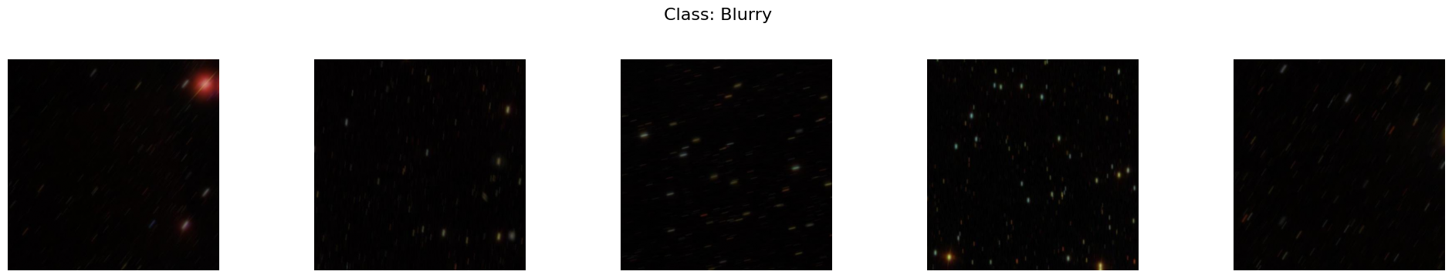
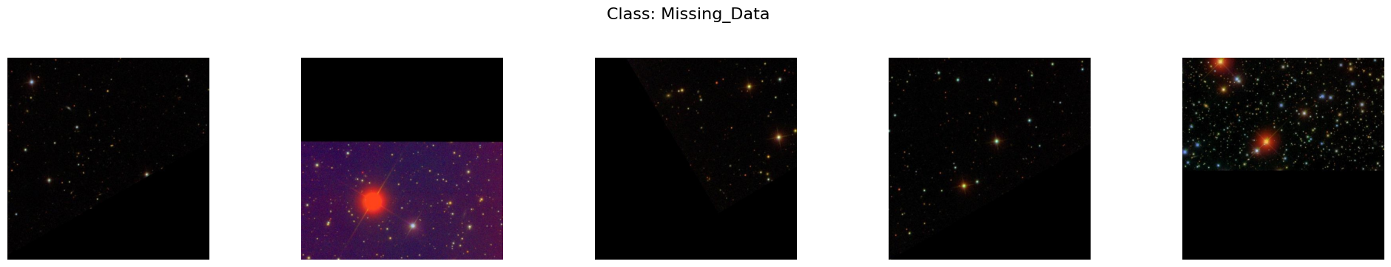
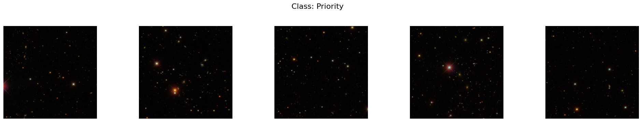

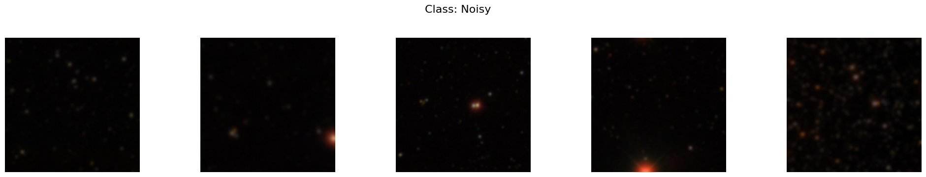
Labels
Blurry
Missing data
Priority
Corrupt
Noisy

Slide 4
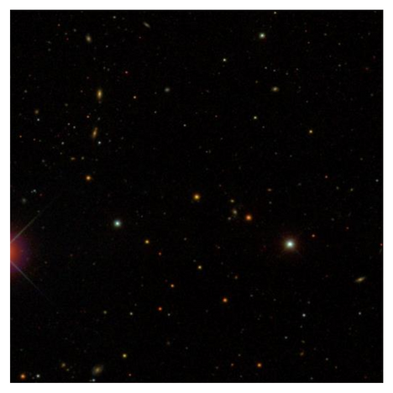


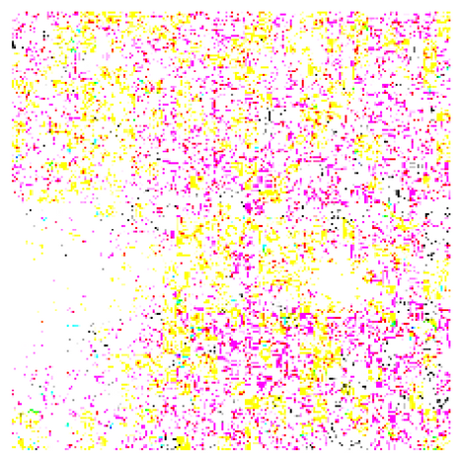
Preprocessing techniques
Resize images
Normalizing
Resized images from (512, 512) to (224, 224)
Normalize from [0, 255] to [-1, 1]
image = tf.image.resize(image, (224, 224))

Slide 5
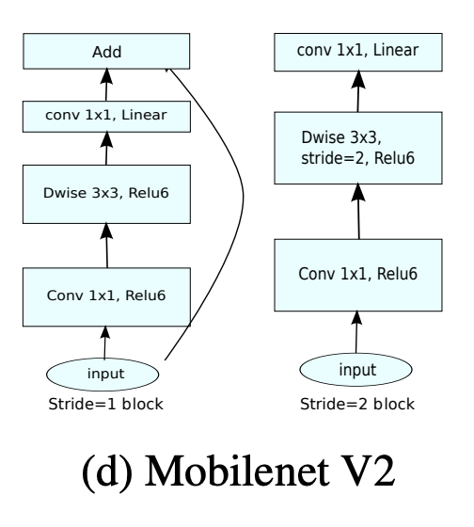
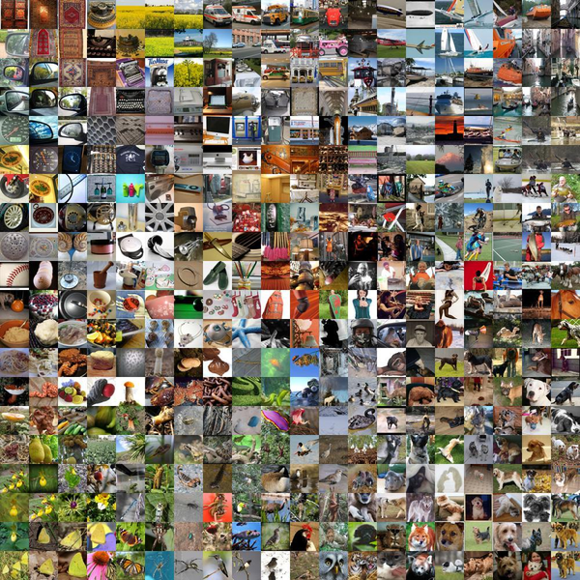
Transfer Learning with MobileNetV2
We use MobileNetV2, a lightweight convolutional neural network optimized for efficiency, making it ideal for devices with limited resources like CubeSats. It balances accuracy and computational cost through depthwise separable convolutions.
Base_model
weights='imagenet'
+
=
include_top = False
alpha = 0.35
input_shape=(224, 224, 3)
base_model.trainable = False

Slide 6
CNN Model
Model Architecture
Training
Base_Model
Epochs = 10
GlobalAveragePooling2D()
Batch_size = 32
Dense(5, activation = ‘softmax’)
Pipeline determined through experimentation -> We have varied the preprocessing techniques and the model and training parameters

Slide 7
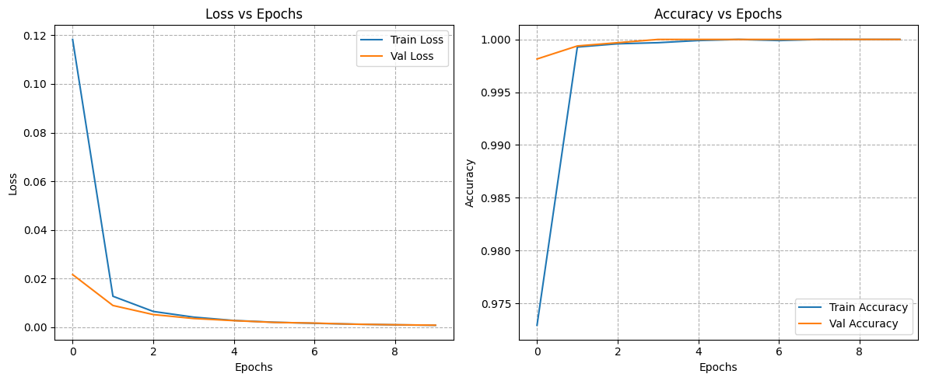
Training and Validation Results

Slide 8
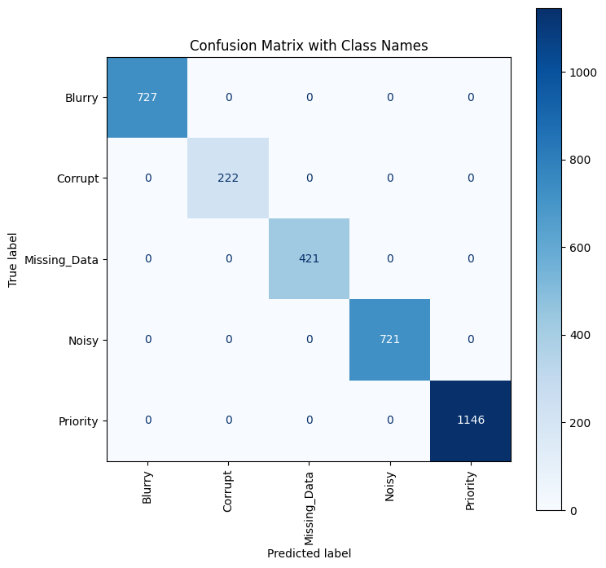
Training and Validation Results

Slide 9
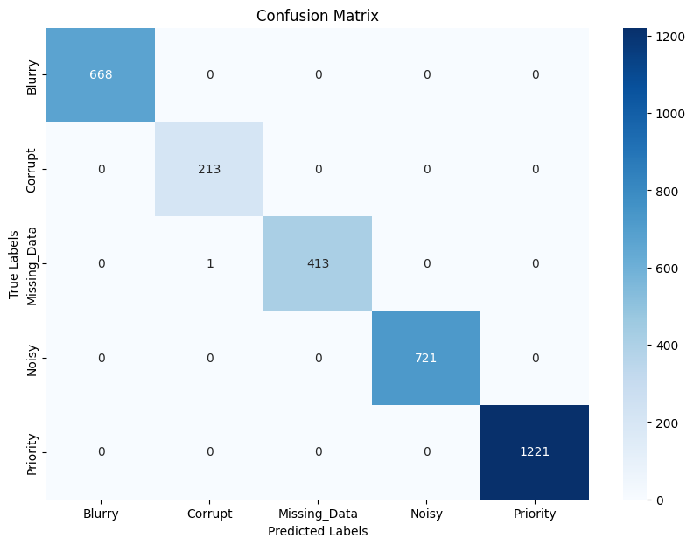
Evaluation
Evaluation Time: 27.25 seconds
Peak Memory Usage: 12738.03 MB
Average CPU Usage: 390.41 %
Algorithm code size: 2.17 MB
Accuracy: 1.000
F1 Score: 1.000

Slide 10


Original
Our model
Evaluation Time: 265.27 seconds
Peak Memory Usage: 8455.79 MB
Average CPU Usage: 89.29 %
Algorithm code size: 1.16 MB
Accuracy: 0.998
F1 Score: 0.998
Evaluation Time: 27.25 seconds
Peak Memory Usage: 12738.03 MB
Average CPU Usage: 390.41 %
Algorithm code size: 2.17 MB
Accuracy: 1.000
F1 Score: 1.000

Slide 11
Pros and cons
Original
Our model
Slow
~10x Faster
Very good accuracy
Even more accurate
~8GB peak RAM
~12GB peak RAM (~150%)
Uses 1 CPU
Uses 3 CPUs
More flexible
“Black box”

